Slide 1
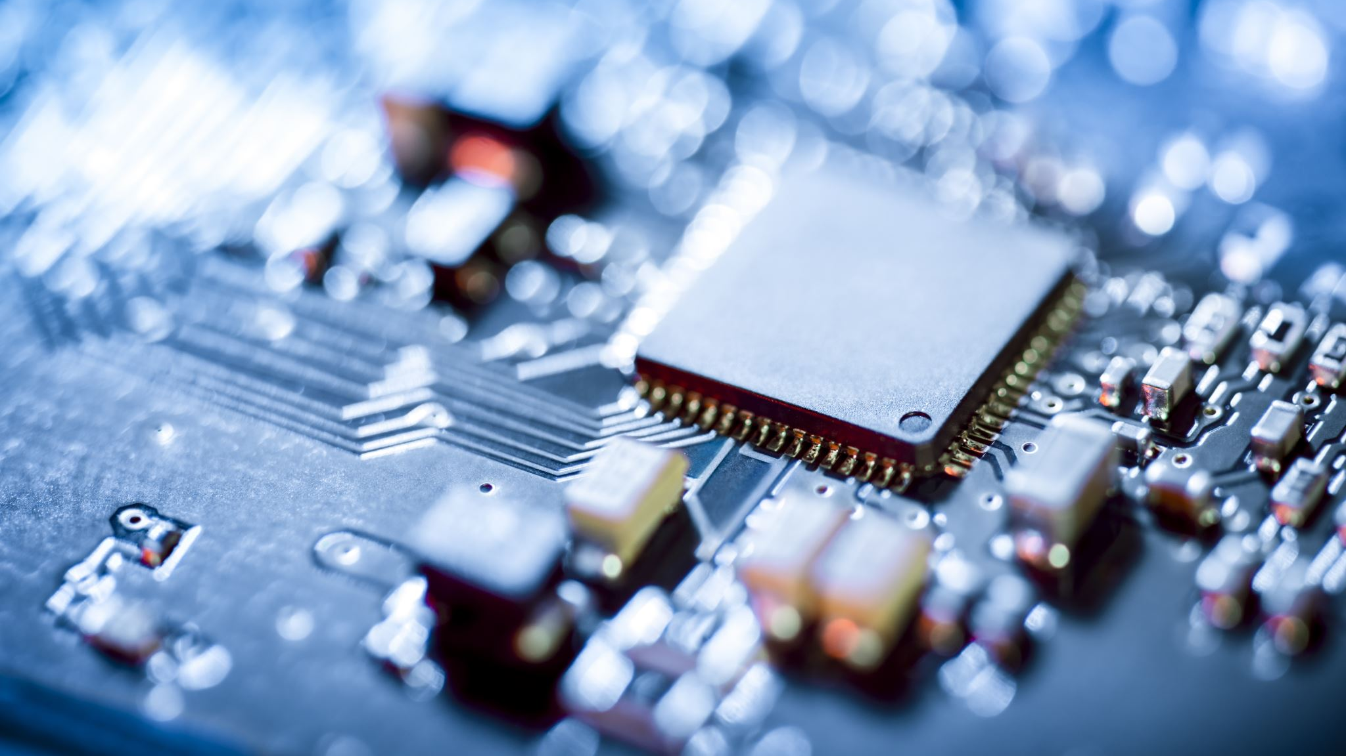
8086 Assembly
Problem Set 5

Slide 2
UART Interface
UART is an interface like any other serial interface I2C, SPI, and so on
UART is commonly used between computers and modems, but it can be used between two computers directly
UART serial port has a standard pin configuration, however the usage of the pins depends on the use case of the system
In PC-to-PC connection (without modems) the pins are connected as follows: RXD-TXD, TXD-RXD, GND-GND, and all other pins are not used (only used if strictly needed)
In PC-to-modem connection (modem can be connected to another PC, another modem, a phone, or any other device): all pins are used between the two UART ports on the PC and the modem.

Slide 3
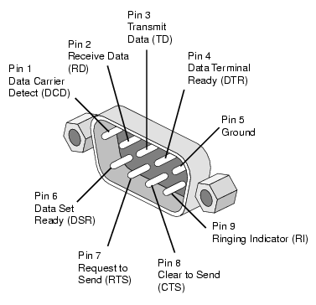
RS232 Port
Pin | SIG. | Signal Name | Direction | Explanation
1 | DCD | Data Carrier Detect | From modem to PC | Indicates that the modem has detected a carrier signal from a remote device
2 | RXD | Receive Data | From modem (or a PC) to PC | -
3 | TXD | Transmit Data | From PC to modem (or a PC) | -
4 | DTR | Data Terminal Ready | From PC to modem | Tells the modem that the computer is ready
5 | GND | Signal Ground | - | -
6 | DSR | Data Set Ready | From modem to PC | Tells the computer that the modem is powered on and ready
7 | RTS | Request to Send | From computer to PC | Indicates the computer wants to send data
8 | CTS | Clear to Send | From modem to PC | Modem responds that it's ready to receive data
9 | RI | Ring Indicator | From modem to PC | Alerts the computer that the phone line is ringing (in special modems)

Slide 4
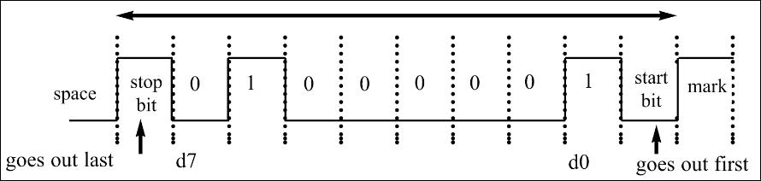
UART Frame

Slide 5
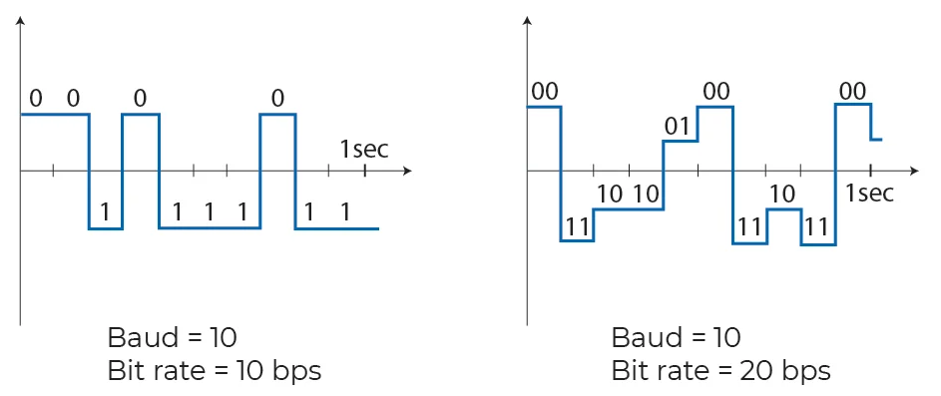
Baud Rate vs Bit Rate
Baud rate = Number of level changes per second
Bit rate = Number of bits transmitted per second

Slide 6
Serial Comm. In 8086
Two Methods to Use Serial Communications in 8086 Assembly
Using Interrupt 14h
To Initialize COM Port
INT 14H, DX = Port Number, AH = 0, AL = configuration
To send a character
INT 14H, DX = Port Number, AH = 1, AL = character
To receive a character
INT 14H, DX = Port Number, AH = 3 (to get COM port status in register AH)
To read the received character
INT 14H, DX = Port Number, AH = 2 (AL holds the character upon return)
Using IN / OUT Instruction Directly

Slide 7
Serial Ports
Base Address
COM Port | IO Port
COM1 | 0x3F8
COM2 | 0x2F8
COM3 | 0x3E8
COM4 | 0x2E8
Registers Offsets
COM Port | IO Port
I/O Data Register / Lower Baud Rate Divisor Register | 0x000
Higher Baud Rate Divisor Register | 0x001
Line Control Register | 0x003
Line Status Register | 0x005

Slide 8
Data Register
The transmitter / receiver data register is internally composed of two internal registers:
Register | Direction | Role | Common Flag
Transmit Holding Reg (THR) | Output (Transmit) | Holds data to send | THRE (THR Empty)
Receiver Buffer Reg (RBR) | Input (Receive) | Holds received data | RDR (Receiver Data Ready)
Both registers use the same port address without conflicts because writes and reads are mutually exclusive in behavior

Slide 9
Line Control Register
Bit 7 | 1 |  |  | Divisor Latch Access Bit
 | 0 |  |  | Access to Receiver buffer, Transmitter buffer
Bit 6 | Set Break Enable
Bits 3, 4 And 5 | Bit 5 | Bit 4 |  | Bit 3 | Bit 3 | Parity Select | Parity Select
 | X | X |  | 0 | 0 | No Parity | No Parity
 | 0 | 0 |  | 1 | 1 | Odd Parity | Odd Parity
 | 0 | 1 |  | 1 | 1 | Even Parity | Even Parity
 | 1 | 0 |  | 1 | 1 | High Parity (Sticky) | High Parity (Sticky)
 | 1 | 1 |  | 1 | 1 | Low Parity (Sticky) | Low Parity (Sticky)
Bit 2 | Length of Stop Bit
 | 0 |  | One Stop Bit
 | 1 |  | 2 Stop bits for words of length 6,7 or 8 bits or 1.5 Stop Bits for Word lengths of 5 bits.
Bits 0 And 1 | Bit 1 |  | Bit 0 |  |  | Word Length
 | 0 |  | 0 |  |  | 5 Bits
 | 0 |  | 1 |  |  | 6 Bits
 | 1 |  | 0 |  |  | 7 Bits
 | 1 |  | 1 |  |  | 8 Bits

Slide 10
Baud Rate Divisor Register Values
Bits Per Second | 3F9/3F9 Value | 3F8/2F8 Value
110 | 4 | 17h
300 | 1 | 80h
600 | 0 | C0h
1200 | 0 | 60h
1800 | 0 | 40h
2400 | 0 | 30h
3600 | 0 | 20h
4800 | 0 | 18h
9600 | 0 | 0Ch
19.2K | 0 | 6
38.4K | 0 | 3
56K | 0 | 1
For Hardware Design Reasons (resampling rate)
Assuming Clock = 1.8432 MHz

Slide 11
Line Status Register
Bit | Notes
Bit 7 | Error in Received FIFO
Bit 6 | Transmitter shift Register is Empty
Bit 5 | Transmitter Holding Register is Empty (You can send data)
Bit 4 | Break Interrupt
Bit 3 | Framing Error
Bit 2 | Parity Error
Bit 1 | Overrun Error occurs when another byte of data arrives even before the previous byte has not been read from the UART's receive buffer.
Bit 0 | Data Ready (You received data)

Slide 12
Problem 1
Calculate the overhead percentage if the data size is 6, 2 stop bits, even parity.
1 start bit
2 stop bits
1 parity bit
Overhead=Extra/total=4/(6+4) *100=40%

Slide 13
Problem 2
True or false. The longer the cable, the higher the data transfer baud rate. Why?
False.
The baud rate is the rate at which information is transferred in a communication channel

Slide 14
Problem 3
It is required to transfer 2 Gigabytes of data between two PCs. The distance between these PCs is 600 m. What is the best transmission method to be used? (Serial/ Parallel – synchronous/ asynchronous)
Serial since long distance.
Synchronous since large data to decrease overhead.
Synchronous - transfers a block of data (characters) at a time.
Asynchronous - transfers a single byte at a time.

Slide 15
Problem 4
Calculate the total number of bits transferred if 200 pages of ASCII data are sent using asynchronous serial data transfer. Assume a data size of 8 bits, 1 stop bit, no parity.
Sent bits per char=1+8+1
Num of char per page=80*25
Total transferred bits= 10*200*80*25= 4*10^6 bits

Slide 16
Problem 5
X_{in} = 3.072 MHz Calculate the baud rate divisor for each of the following baud rates: 110, 300, 9600.
3.072*10^6/110*16=1745.454545
Divisor = round(1745.45)=1745,
percent error=(1745.454545-1745)/1745.454545 *100=0.026
3.072*10^6/300*16=640
3.072*10^6/9600*16=20

Slide 17
Problem 6
What is data overrun?
Overrun error occurs when another byte of data arrives before the previous byte has been read from the UART's receive buffer. This is mainly due to time taken by CPU to service the UART interrupt to remove characters from receive buffer. If the CPU does not service the UART interrupt quick enough and does not read the received byte before the next arrives, then the buffer becomes full, and an Overrun error occurs.

Slide 18
Problem 7
Assuming that we are transmitting letter "D", binary 1000100, with odd-parity bit and 2 stop bits
show the sequence of bits transferred.
find the overhead due to framing.
Calculate the time it takes to transfer 400 characters if we use 1200 bps. What percentage of time is wasted due to overhead?
a) 111100 0100 0
Red: start bit
Blue: stop bits
Black: data bits
Green: parity bit
b) Overhead=4 bits/ frame, Frame=7+4=11 bits
c) Transfer time=11*400 bits/1200=11/3=3.67 seconds
Overhead time=4*400/1200=4/3=1.33 seconds
%time wasted=(4/3)/(11/3)=36.4%

Slide 19
Problem 8
If in a given PC the COM port is defective, which handshake signal indicates this to the modem?
DTR (data terminal ready) - when a terminal or PC COM port is turned on, after self-test, it sends signal DTR to indicate it is ready for communication.

Slide 20
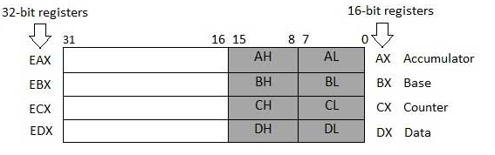
Problem 9
In a 386/486 program, show the content of each register indicated in parentheses after execution of the instruction.
MOV EAX,9823F4B6H (AL, AH, AX and EAX)
MOV EBX,985C2H (BL, BH, BX, EBX)
MOV EDX,2000000 (DL, DH, DX, EDX)
MOV ESI,120000H (SI, ESI)
a) MOV EAX,9823F4B6H
(AL=B6, AH=F4, AX=F4B6 and EAX=9823F4B6)
b) MOV EBX,985C2H (BL=C2, BH=85, BX=85C2, EBX=000985C2)
c) MOV EDX,2000000 =001E8480 (DL=80, DH=84, DX=8480, EDX=001E8480)
d) MOV ESI,120000H (SI=0000, ESI=00120000)

Slide 21
Problem 10
Using the little-endian convention show the contents of the destination in each case.
a. MOV [SI], EAX; SI=2000H , EAX=9823F456H
56h at DS:2000h
F4h at DS:2001h
23h at DS:2002h
98h at DS:2003h
b. MOV [BX], ECX; BX=348CH, ECX=1F23491H
91h at DS:348Ch
34h at DS:348Dh
F2h at DS:348Eh
01h at DS:348Fh
c. MOV EBX, [DI]; DI=4044H
DS:4044= 92H
DS:4045= 6DH
DS:4046= A2H
DS:4047= 4CH
EBX=4CA26D92h

